Slide 1






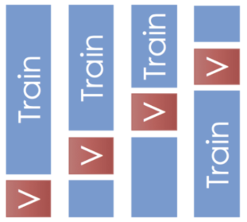

Data collection process from SpaceX API
Riccardo Saruis
SpaceX
REST API
LeaveOneGroupOut nested cross validation
+ Ensamble
API returns SpaceX data in .JSON
Train
Test
split
Data pre-processing
Features
and
Lables
definition
Results
Conclusions
EDA
SpaceX
REST API

Slide 2

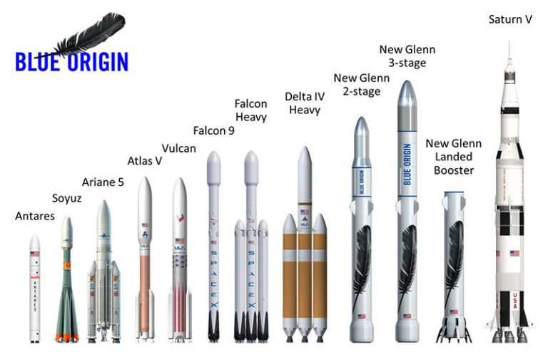

Slide 3
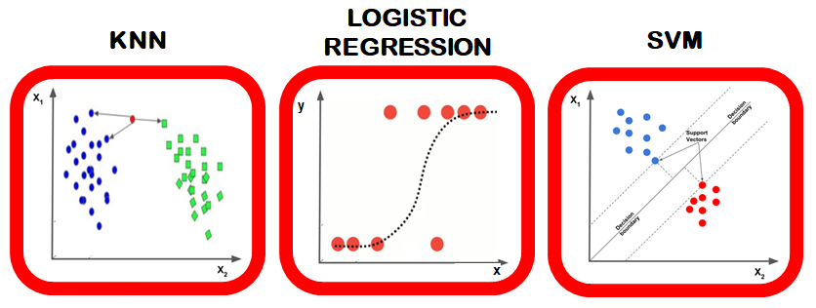
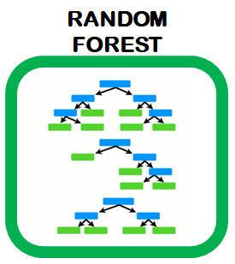

Slide 4
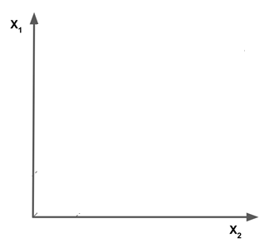
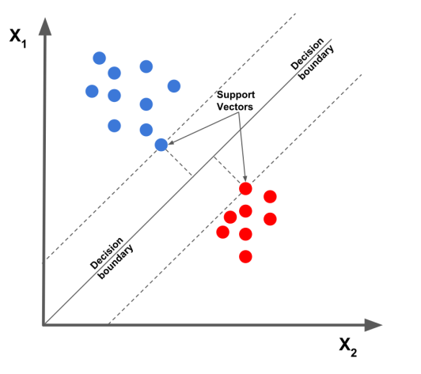
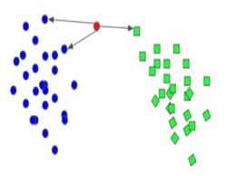


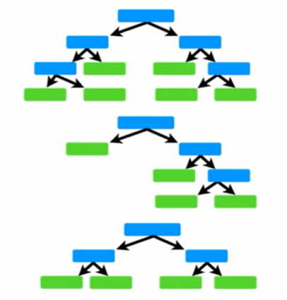
LOGISTIC REGRESSION
KNN
SVM
y
x
RANDOM
FOREST

